Slide 1


A
On the Job Training Report
on
Effective Tracking of Overall Equipment Efficiency (OEE)
SUBMITTED BY
Shreyas Auti
MBA –III Semester
UNDER THE GUIDANCE OF
Mr. Harshal Patil

Slide 2
Institute Certificate

Slide 3
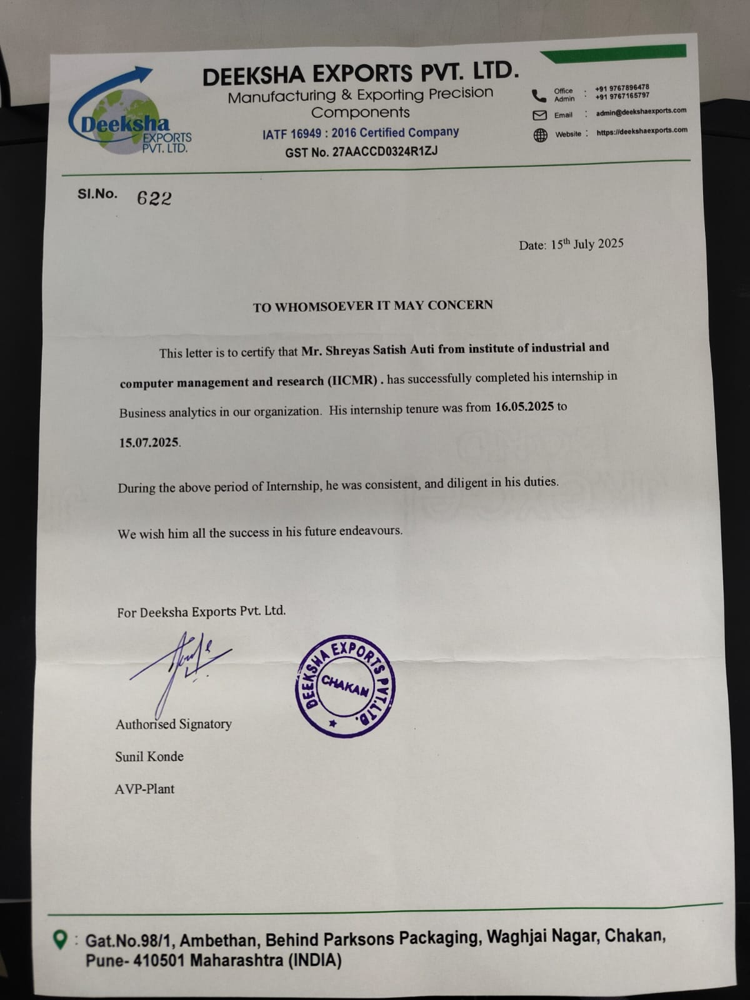
Company Certificate

Slide 4

Flow of the Presentation - INDEX
Sr. No. | Particulars
1 | Executive Summary
2 | I – Outline of the Problem/ Task Undertaken:
3 | II - Review of the Literature:
4 | III- Methodology:
5 | IV – Data Analysis and Interpretation:
6 | V – Results / Findings & Suggestions:
7 | Uniqueness of the Project
8 | Key Insights
9 | Annexure

Slide 5
Executive Summary
Key Metrics (4 Months)
Availability: 79.62%
Performance: 84.08%
Quality: 99.69%
Overall OEE: 66.74%
Highlights
Top Machines – Chromating & Vacuum M/c (87.5% OEE)
Low Performing – CNC 1 M/c (62.63% OEE) Major Downtime – VMC 9 M/c (12.12K mins) Highest Rejections – Small RV Housing (485 units)
Observations
Consistently high quality, but efficiency dragged by downtime.
VMC series machines are most breakdown-prone.
Fluctuating OEE trend with lowest dips in May (41%).
Recommendations
Implement Predictive Maintenance on critical VMCs.
Train operators on downtime reduction & quick changeovers.
Use real-time dashboards for daily monitoring.
Root cause analysis for Small RV Housing rejections.

Slide 6
I - Outline of the Problem/ Task Undertaken:
Problem Statement “The absence of a centralized and systematic OEE tracking system at Deeksha Exports Pvt. Ltd. has led to inefficiencies in identifying downtime, monitoring performance, and minimizing rejections, thereby limiting overall productivity.”
Data Handling
Collected machine breakdown & production reports from Tally.
Cleaned and structured raw data in Excel.
Dashboard Development
Built Power BI dashboard for OEE tracking.
Visualized Availability, Performance, Quality, and Overall OEE.
Created machine-wise and product-wise comparisons.

Slide 7
I - Outline of the Problem/ Task Undertaken:
Reporting & Insights
Prepared detailed OEE interpretation & findings.
Suggested process improvements (predictive maintenance, RCA for rejections).
Delivered a final OJT report with recommendations.
Analysis
Identified top 5 machines with highest downtime.
Monitored OEE trends across 4 months (Mar–Jun 2025).
Analyzed rejection rates by product.

Slide 8
I – Objectives:
Primary Objectives
To track and evaluate OEE (Overall Equipment Efficiency) across critical machines.
To analyze downtime, performance loss, and quality issues using Tally-exported data.
To develop a Power BI dashboard for real-time visibility of OEE metrics.
Secondary Objectives
Identify machines with high breakdown frequency and low OEE.
Monitor rejection trends by product and suggest improvements.
Recommend data-driven solutions for productivity enhancement.
Contribute to building a culture of efficiency monitoring within the organization.

Slide 9
II - Review of the Literature:
The concept of Overall Equipment Efficiency (OEE) was introduced by Nakajima (1988) as a part of Total Productive Maintenance (TPM). OEE measures the effectiveness of manufacturing equipment using three factors: Availability, Performance, and Quality.
According to Nakajima (1988), TPM emphasizes zero breakdowns, zero defects, and zero accidents, which directly influence OEE outcomes. He also established the world-class OEE benchmark at 85%, where Availability should exceed 90%, Performance above 95%, and Quality above 99%.
Research by Muchiri and Pintelon (2008) highlighted that OEE has become a key performance indicator (KPI) in lean manufacturing systems, allowing organizations to benchmark and improve operational efficiency.
Further, Dal, Tugwell, and Greatbanks (2000) analyzed OEE losses in real manufacturing environments and concluded that downtime and changeovers remain the leading causes of reduced efficiency.
Recent work by Bokrantz et al. (2020) suggests that integrating IoT technologies and dashboards enables real-time OEE monitoring, thus enhancing data-driven decision-making and predictive maintenance practices.

Slide 10
III Methodology:
Approach
Analytical & descriptive study
Based on real machine data from Tally (Mar–Jun 2025)
Data Collection
Primary Data
Machine breakdown logs
Production reports
Operator inputs
Secondary Data:
Company SOPs & manuals
Literature on OEE & TPM

Slide 11
III Methodology:
Tools & Techniques
Excel: Data cleaning & tabulation
Power BI: Dashboard creation & trend analysis
OEE Formula: Availability × Performance × Quality
Sampling
Focused on 15 machines (CNC & VMC series, Ball Assembly, Chromating M/c)
Time frame: 4 months

Slide 12
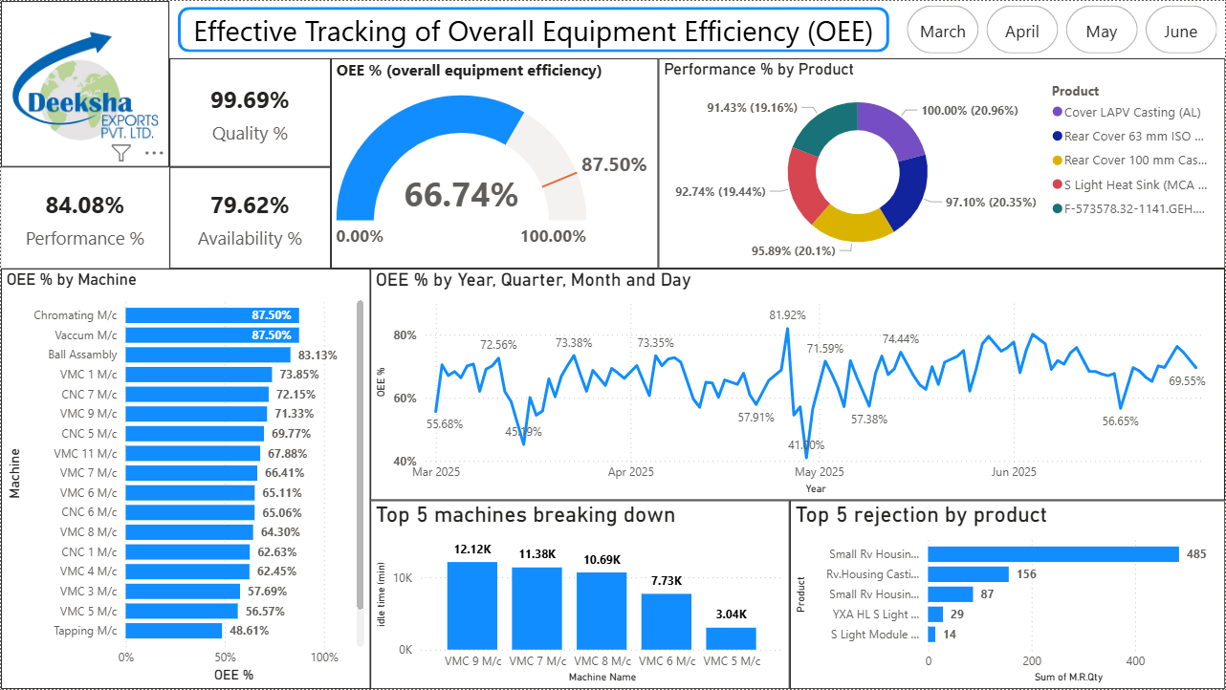
IV – Data Analysis and Interpretation:

Slide 13
IV – Data Analysis and Interpretation:
OEE Summary (Mar–Jun 2025):
Availability: 79.62%
Performance: 84.08%
Quality: 99.69%
Overall OEE: 66.74% (below benchmark 85%)
Machine-wise OEE:
Chromating & Vacuum M/c: 87.5%
Ball Assembly: 83.13%
CNC 1 M/c: 62.63% (Lowest)
Downtime Analysis:
VMC 9 M/c: 12.12K mins
VMC 7 M/c: 11.38K mins
VMC 8 M/c: 10.69K mins
❌ Rejections by Product:
Small RV Housing: 485 units
RV Housing Casting: 156 units
Port Body Casting: 86 units

Slide 14
V – Results / Findings & Suggestions:
Key Findings (Mar–Jun 2025)
Overall OEE: 66.74% (below world-class 85%)
High downtime on VMC machines (VMC 9, 7, 8).
Quality performance strong (99.69%), rejections limited to a few products.
Fluctuating OEE trend, with dips in May (41%).
Suggestions
Predictive Maintenance on critical VMC machines to reduce unplanned downtime.
Apply SMED (Single Minute Exchange of Dies) to minimize changeover losses.
Conduct Root Cause Analysis (RCA) for rejections in Small RV Housing & RV Castings.
Operator training for better handling and faster response to stoppages.
Integrate real-time IoT tracking for continuous OEE monitoring.

Slide 15
Uniqueness of the Project:
What Makes This Project Unique?
Real Industrial Data – Used 4 months of actual Tally-exported machine breakdown & production reports.
Data-Driven Approach – Developed interactive Power BI dashboards instead of relying on manual reporting.
Integrated View – Combined availability, performance, and quality into a single OEE metric.
Action-Oriented Insights – Identified top downtime machines & rejection-heavy products with direct improvement suggestions.
Technology Adoption – Demonstrated how IoT-ready dashboards can modernize shop-floor monitoring.
Practical Contribution – Delivered a ready-to-use tool that management can adopt for daily performance tracking.

Slide 16
Key Insights from the Project:
Performance Overview
Overall OEE averaged 66.74%, below world-class standard (85%).
Quality (99.69%) was strong, but downtime dragged overall efficiency.
Product Insights
Small RV Housing had the highest rejection rate (485 units).
Rejections mainly concentrated in housing castings.
Machine Insights
Top Performers: Chromating & Vacuum Machines (87.5%), Ball Assembly (83.13%).
Critical Issues: VMC 9, VMC 7, and VMC 8 showed the highest downtime (>10K mins).
📈 Trend Insights
OEE peaked at 81.92% (early May).
Lowest dip observed in late May (41%).
Significant fluctuations month-to-month, indicating process instability.

Slide 17
ANNEXURE
Supporting Documents & Data
Machine Breakdown Report (Tally Export – Excel)
Production Report (Tally Export – Excel)
Power BI Dashboard (OEE Analysis: Mar–Jun 2025)
📊 Visuals & Charts
OEE Trend Graph (4 months)
Machine-wise Downtime Analysis
Product-wise Rejection Chart

Slide 18
ANNEXURE
Bibliography
Nakajima, S. (1988). Introduction to TPM: Total Productive Maintenance. Cambridge, MA: Productivity Press.
Muchiri, P., & Pintelon, L. (2008). Performance measurement using Overall Equipment Effectiveness (OEE): literature review and practical application. International Journal of Production Research, 46(13), 3517–3535.
Dal, B., Tugwell, P., & Greatbanks, R. (2000). Overall equipment effectiveness as a measure of operational improvement: A practical analysis. International Journal of Operations & Production Management, 20(12), 1488–1502.
Bokrantz, J., Skoogh, A., Berlin, C., & Stahre, J. (2020). Smart Maintenance: an empirically grounded conceptualization. Journal of Manufacturing Science and Engineering, 142(11).
Company SOPs and internal Tally machine data (Deeksha Exports Pvt. Ltd., 2025).

Slide 19
Thank You

